Slide 1
Dynamic impacts
Science and scenarios
Abatement costs
Instruments for emission reduction
Impacts of climate change; valuation
Economic impacts; marginals; distribution
Impacts and development
Adaptation policy
Optimal climate policy
Discounting, equity, uncertainty

Slide 2
Economic impacts
Why estimate the total economic impact of climate change?
Methods
Results and caveats
Weather v climate
Social cost of carbon
Distribution of impacts
Schelling conjecture
Impact on economic growth
Climate and development

Slide 3
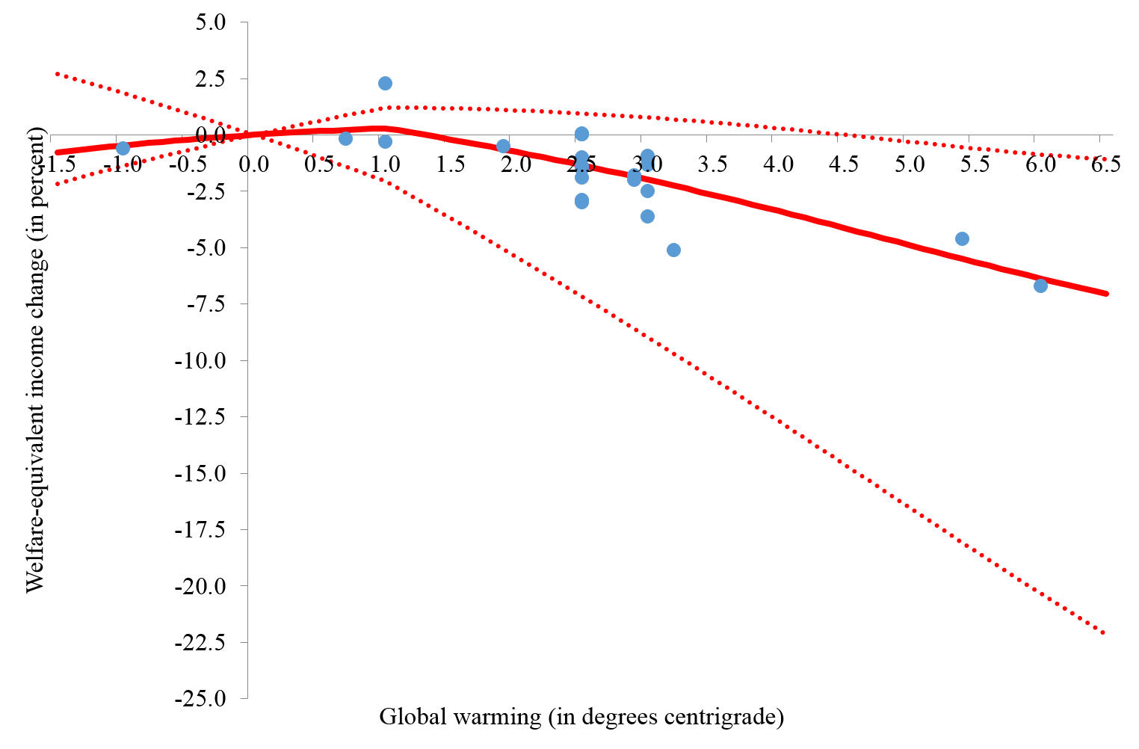

Slide 4
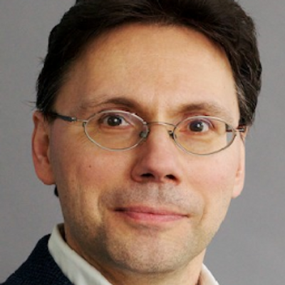
Climate change and growth
Climate change can affect welfare through four channels
Utility (e.g., species loss)
Labour (e.g., morbidity)
Output per worker (e.g., agricultural productivity)
Depreciation (e.g., floods)
Utility: no impact
If output is lower in period t, less is consumed and less is saved, so that there is less capital and less output in period t+1
Ditto for higher depreciation

Slide 5
Climate change and growth -2
In principle, people could compensate through increased savings
Not rational as would cut consumption even more
Besides, the returns to capital have fallen
If the labour force shrinks, there is more capital per worker, higher labour productivity, higher wages
The rational response is to consume the windfall, save less, until the capital-labour ratio is back at its desired value
Effect is small as the health impacts of climate change primarily fall on the non-working population

Slide 6
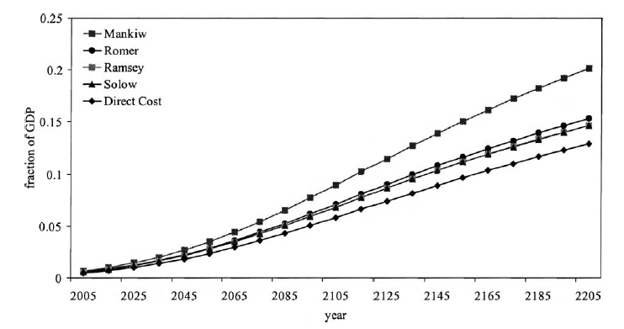

Slide 7
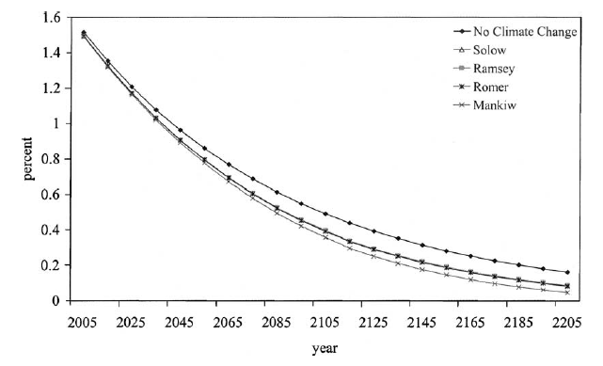

Slide 8
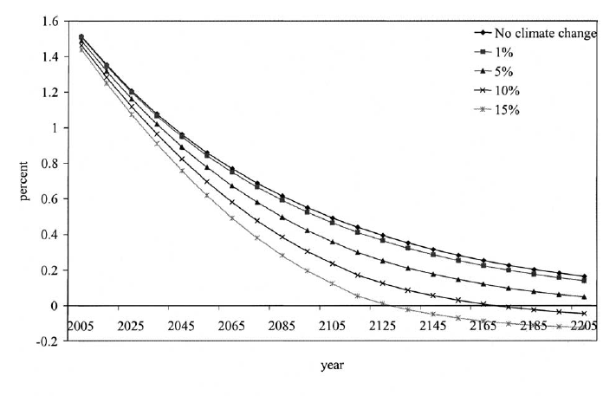

Slide 9
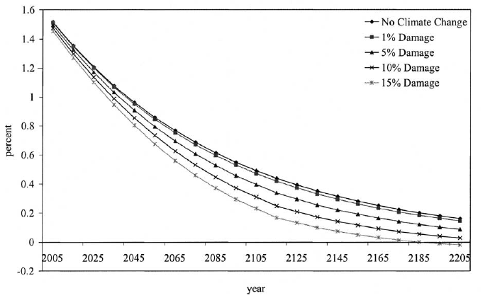

Slide 10
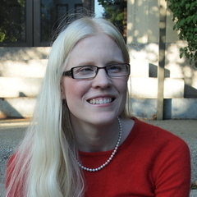
Dell, Jones, Olken, 2012, AEJ Macro

Slide 11
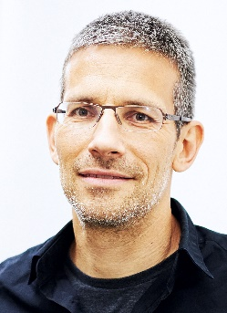
Barrios, Bertinelli, Strobl, 2010, REStat

Slide 12
Economic impacts
Why estimate the total economic impact of climate change?
Methods
Results and caveats
Weather v climate
Social cost of carbon
Distribution of impacts
Schelling conjecture
Impact on economic growth
Climate and development

Slide 13
Climate and poverty
Cool countries tend to be rich, hot countries tend to be poor

Slide 14
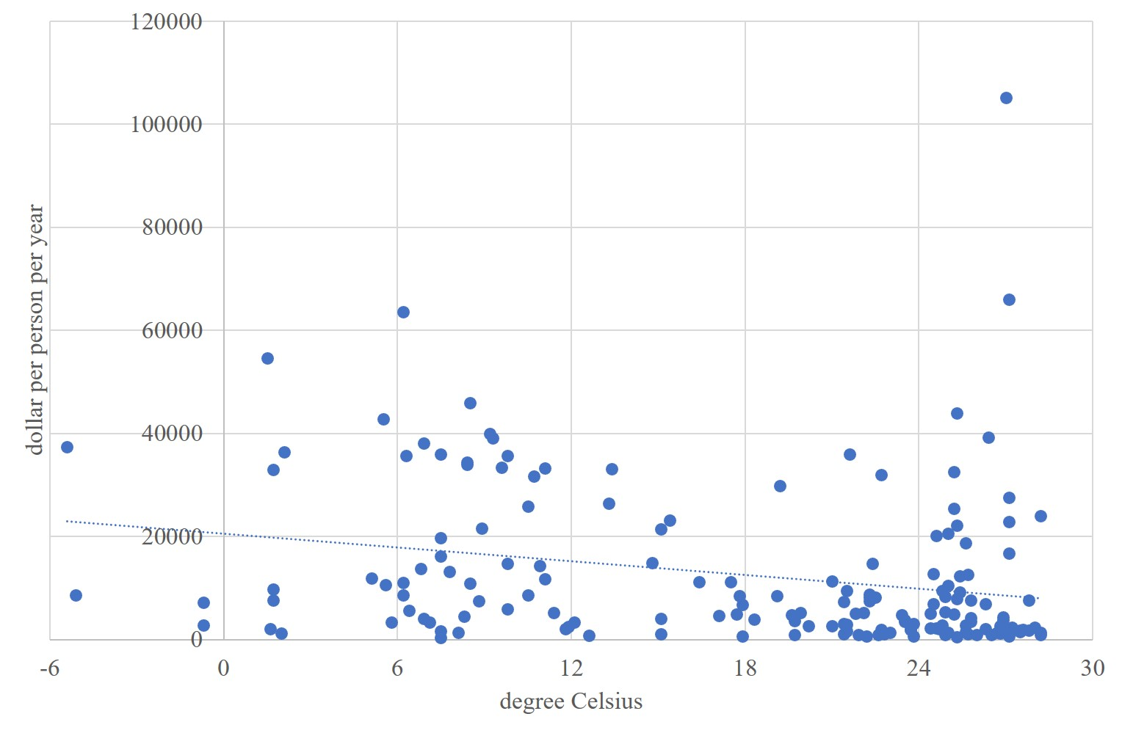
Cool countries tend to be rich, hot countries poor - 2000

Slide 15
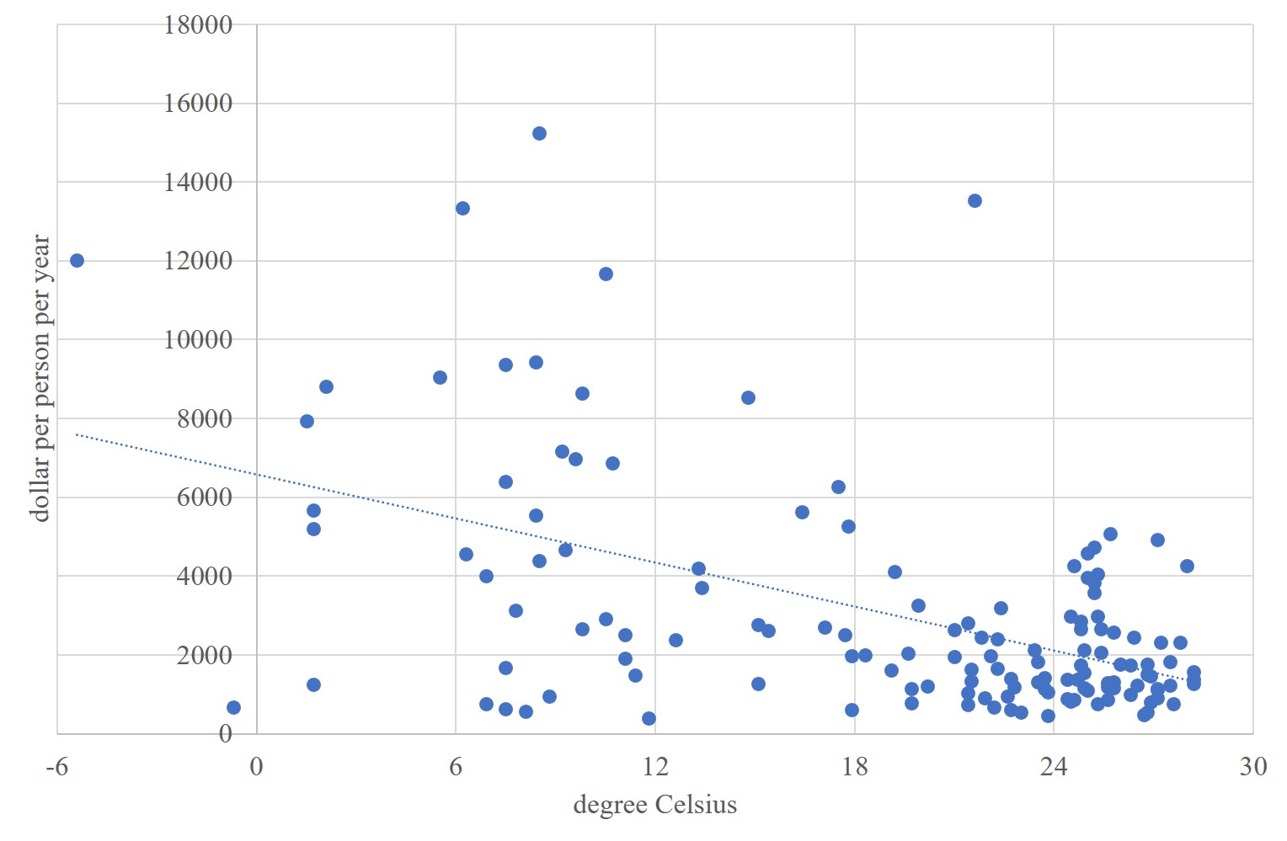
Cool countries tend to be rich, hot countries poor - 1950

Slide 16
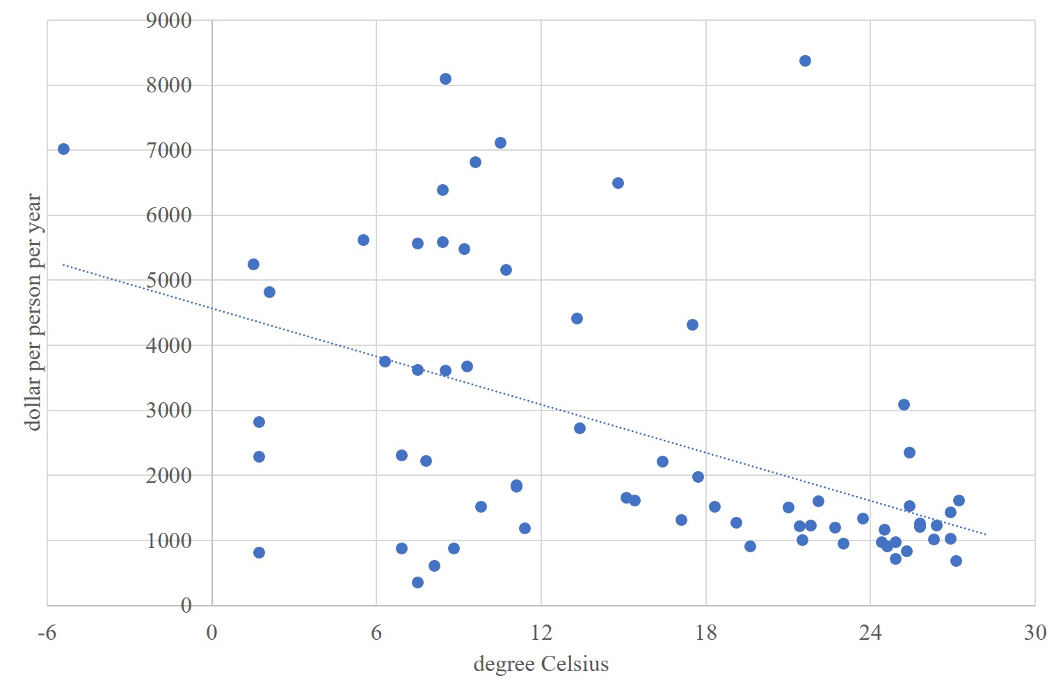
Cool countries tend to be rich, hot countries poor - 1913

Slide 17
Cool countries tend to be rich, hot countries poor - 1900

Slide 18
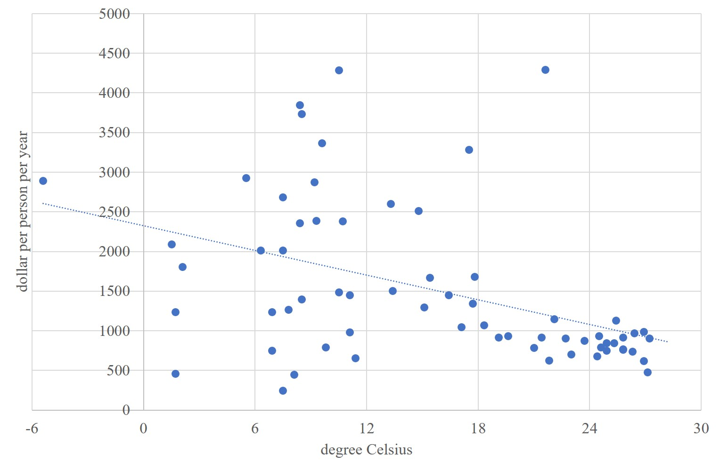
Cool countries tend to be rich, hot countries poor - 1870

Slide 19
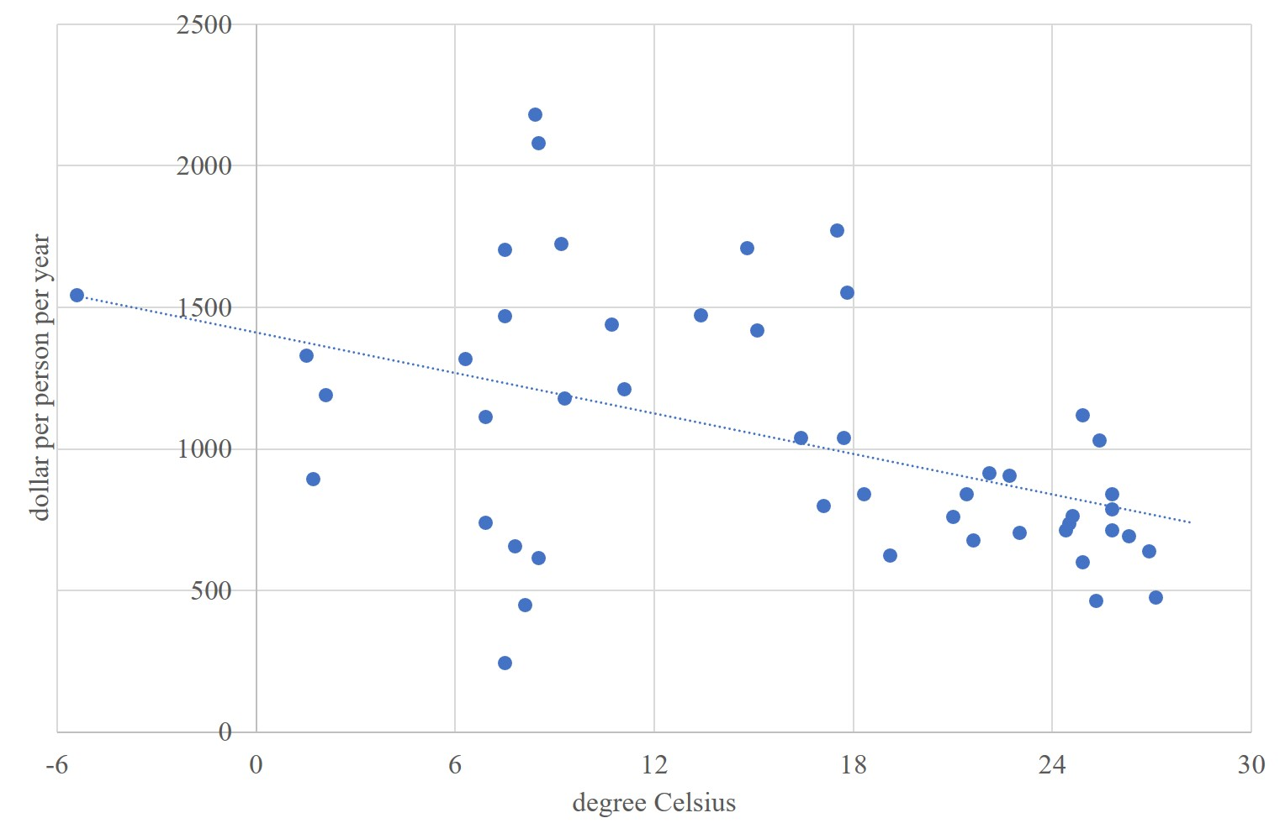
Cool countries tend to be rich, hot countries poor - 1820

Slide 20
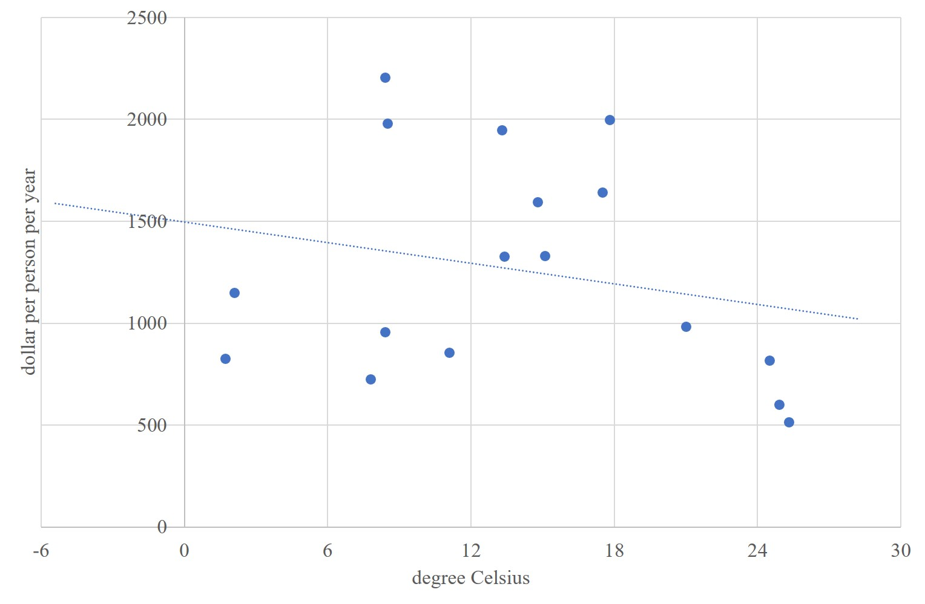
Cool countries tend to be rich, hot countries poor - 1800

Slide 21
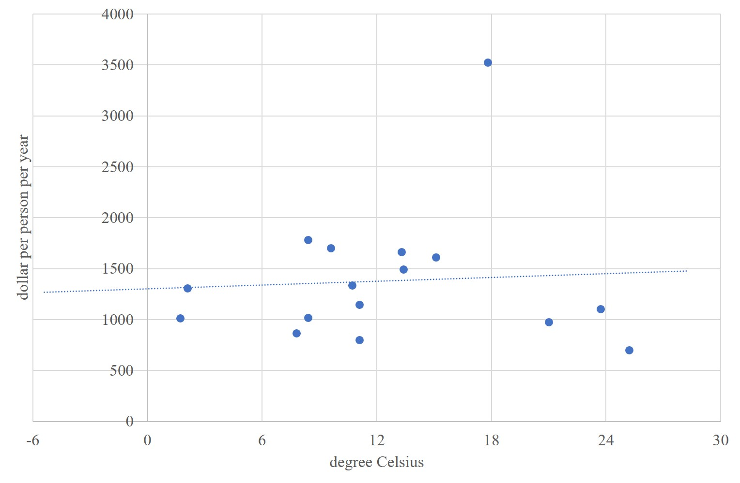
Cool countries tend to be poor, hot countries rich - 1750

Slide 22
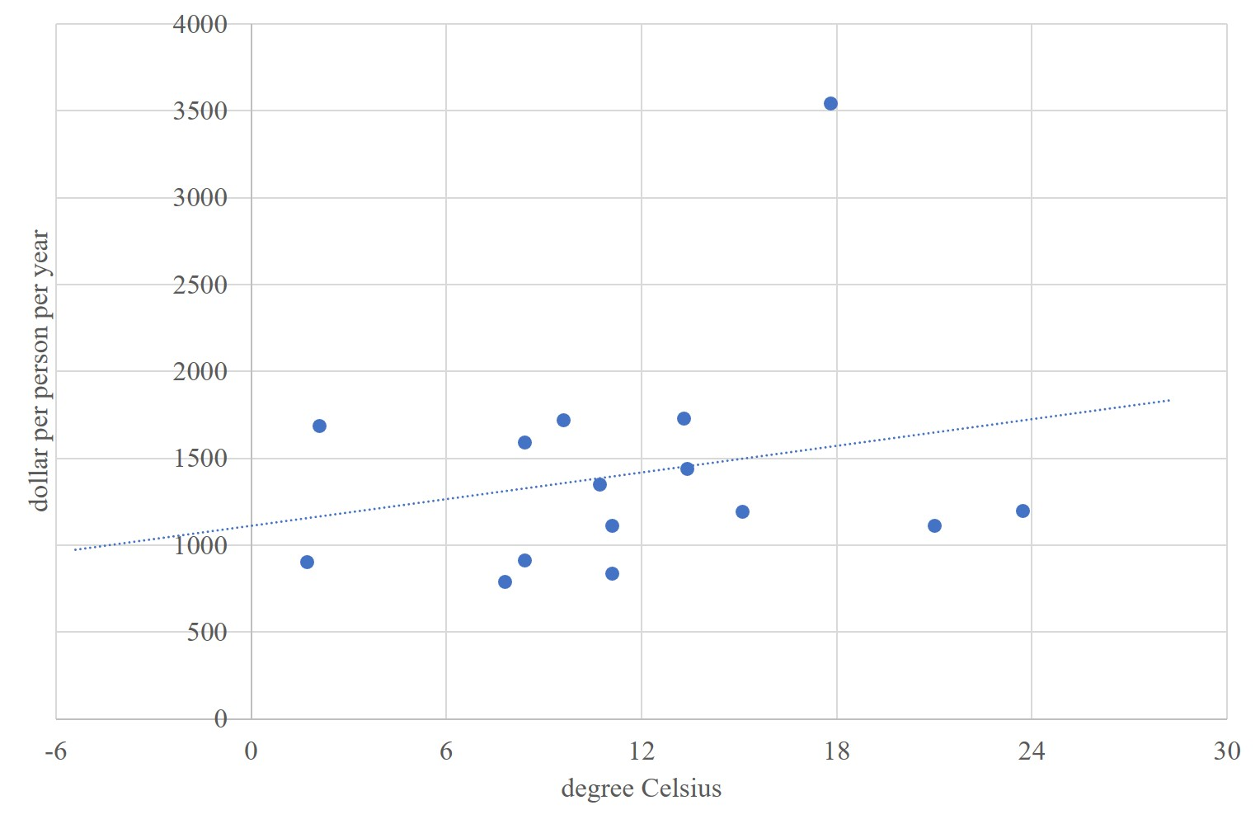
Cool countries tend to be poor, hot countries rich - 1700

Slide 23
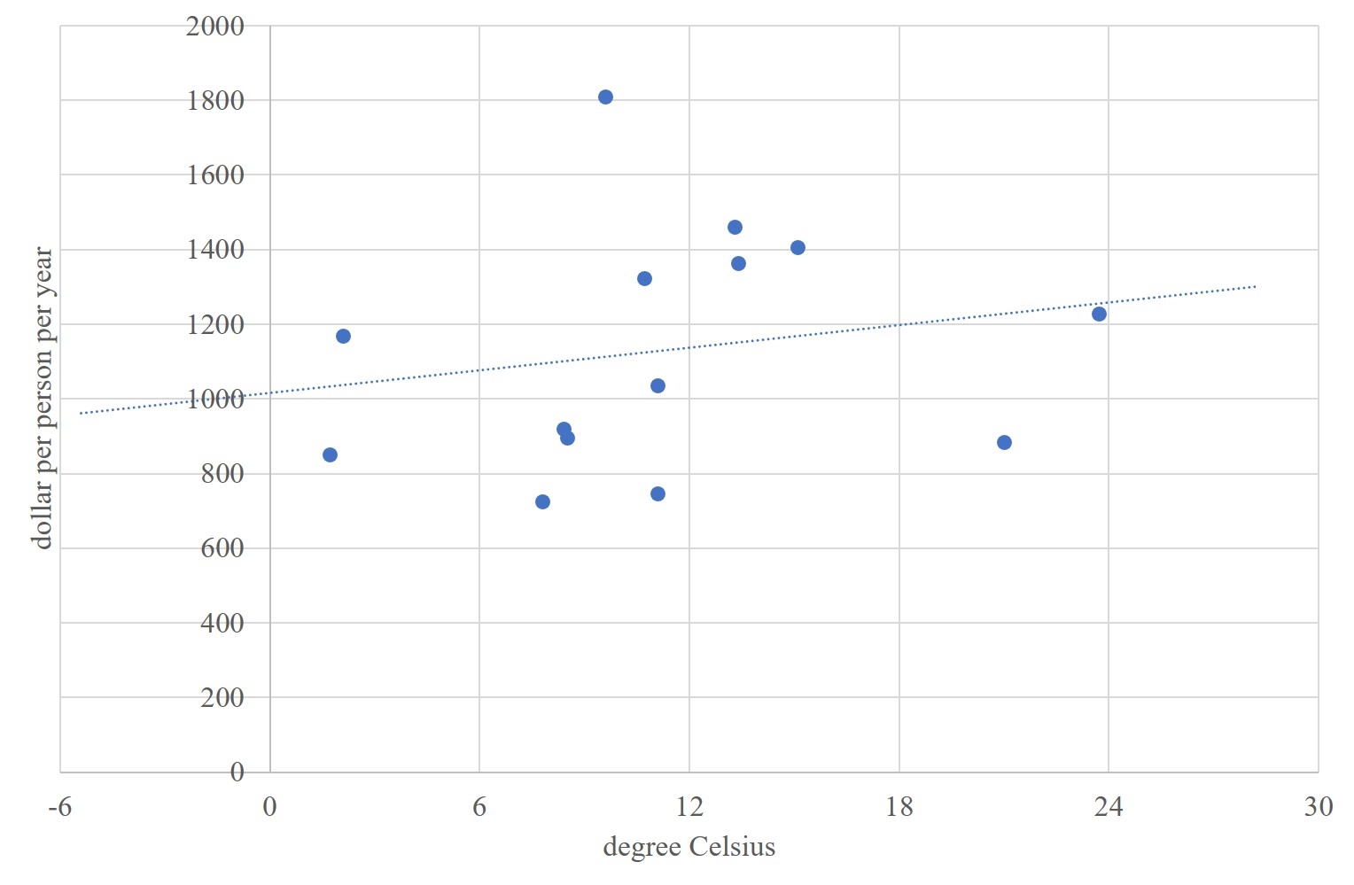
Cool countries tend to be poor, hot countries rich - 1650

Slide 24
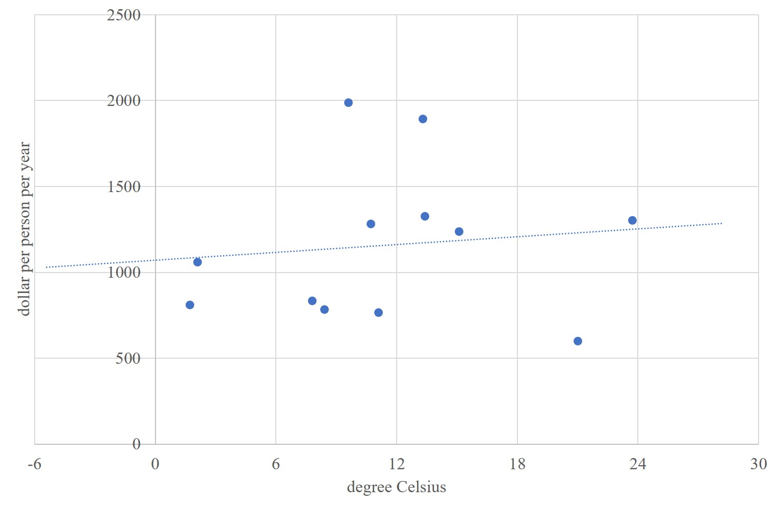
Cool countries tend to be poor, hot countries rich - 1600

Slide 25
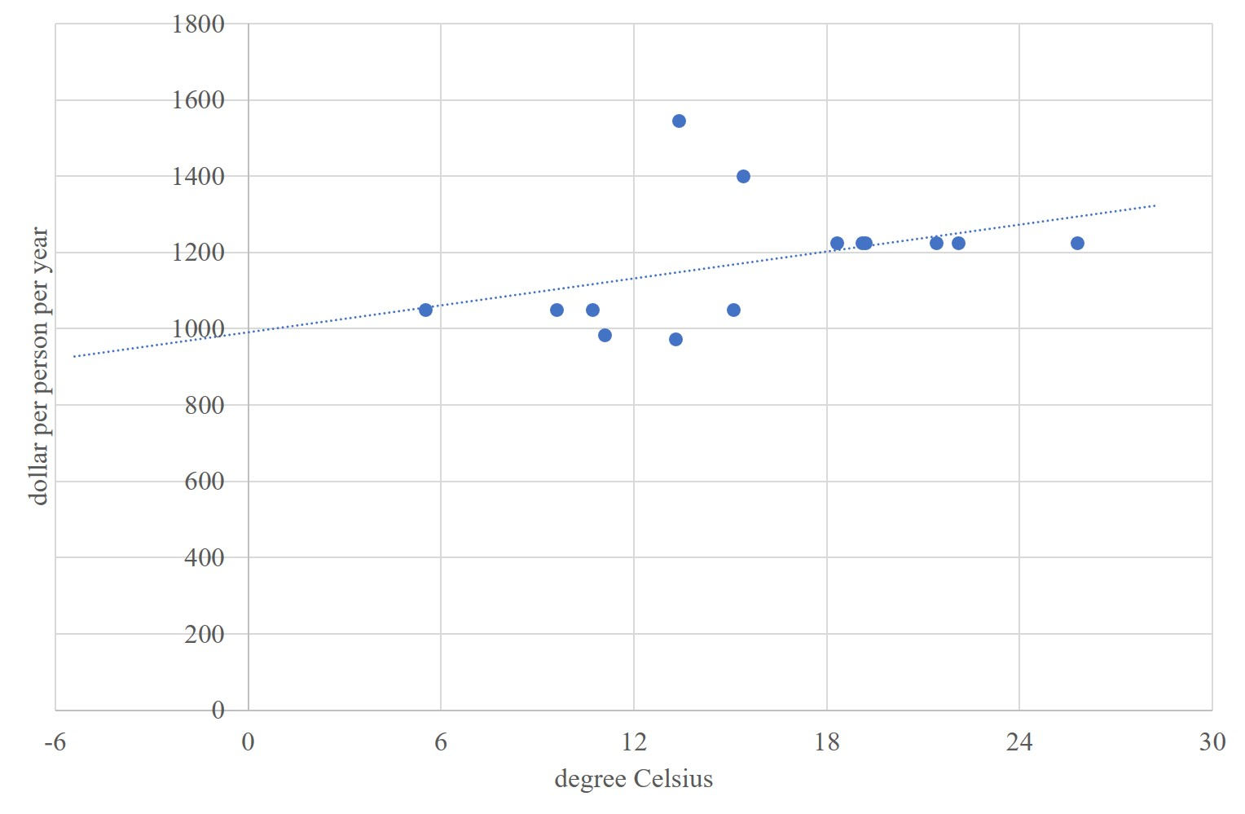
Cool countries tend to be poor, hot countries rich - 0

Slide 26
Climate and poverty
Cool countries tend to be rich, hot countries tend to be poor
Correlation sure, in recent centuries, but causation?

Slide 27
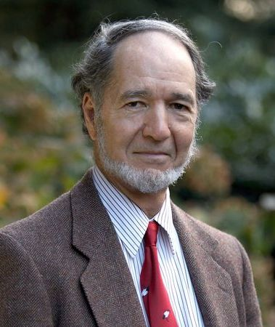
Climate and poverty
Cool countries tend to be rich, hot countries tend to be poor
Correlation sure, in recent centuries, but causation?
Diamond: Climate and geography are destiny

Slide 28
Olsson, Hibbs, 2005, EER

Slide 29
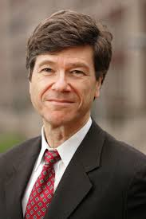
Climate and poverty
Cool countries tend to be rich, hot countries tend to be poor
Correlation sure, in recent centuries, but causation?
Diamond: Climate and geography are destiny
Sachs: Climate and geography are important

Slide 30
Gallup, Sachs, Mellinger, 1999, IRSR

Slide 31
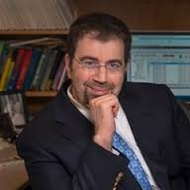
Climate and poverty
Cool countries tend to be rich, hot countries tend to be poor
Correlation sure, in recent centuries, but causation?
Diamond: Climate and geography are destiny
Sachs: Climate and geography are important
Acemoglu: Climate and geography were important

Slide 32
Acemoglu, Johnson, Robinson, 2001, AER

Slide 33

Climate and poverty
Cool countries tend to be rich, hot countries tend to be poor
Correlation sure, in recent centuries, but causation?
Diamond: Climate and geography are destiny
Sachs: Climate and geography are important
Acemoglu, Alsan: Climate and geography helped to shape institutions, but nowadays institutions rule
Easterly, Rodrik: Institutions rule!

Slide 34
Climate and poverty
Cool countries tend to be rich, hot countries tend to be poor
Correlation sure, in recent centuries, but causation?
Diamond: Climate and geography are destiny
Sachs: Climate and geography are important
Acemoglu, Alsan: Climate and geography helped to shape institutions, but nowadays institutions rule
Easterly, Rodrik: Institutions rule!
Nordhaus, Henderson, Kalkuhl: Climate partly explains income distribution within countries

Slide 35
Poverty traps?
If infant mortality is high (and it is in hot and wet climes), parents would have many children to ensure that at least a few survive. Risk-average parents would have more children than they want. Parents could not afford health care and education. Children grow up to be poor too.
If there is a risk of losing it all (and there is in volatile climes), there is no point in saving for the future. A feast and famine culture gets engrained. Also steers investment in non-perishables, such as education.

Slide 36
Climate change and poverty
Climate change could intensify such mechanisms.
This would be an enormous welfare loss.
However, this is still speculative – and it is clear that there is no ground for fatalism
Cultures change
Infectious disease is treatable and preventable

